Slide 1

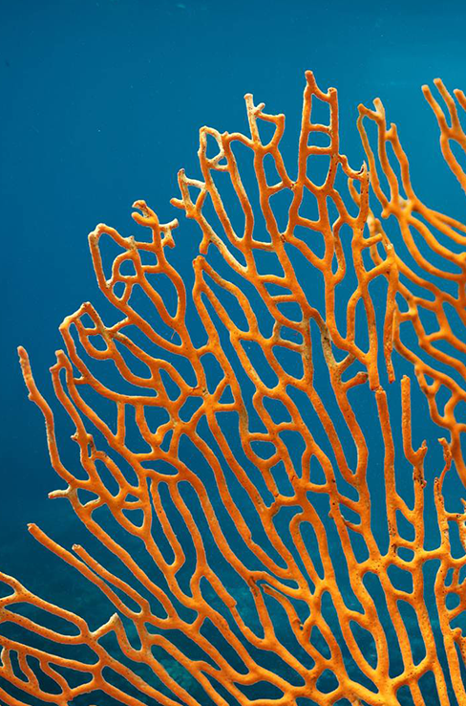
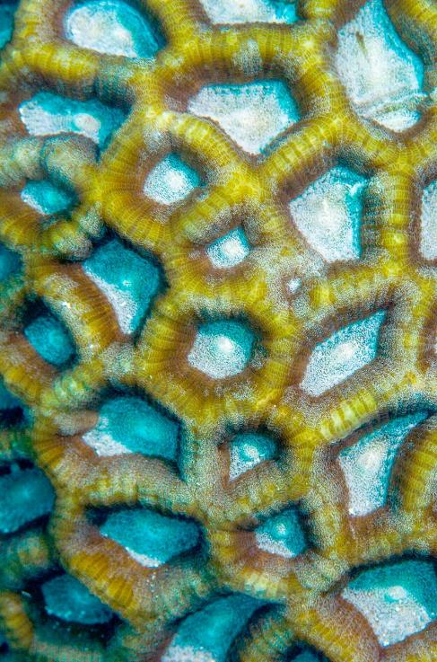

SCUBA VBS 2024
July 14-18
5:00 - 8:00 pm

Slide 2
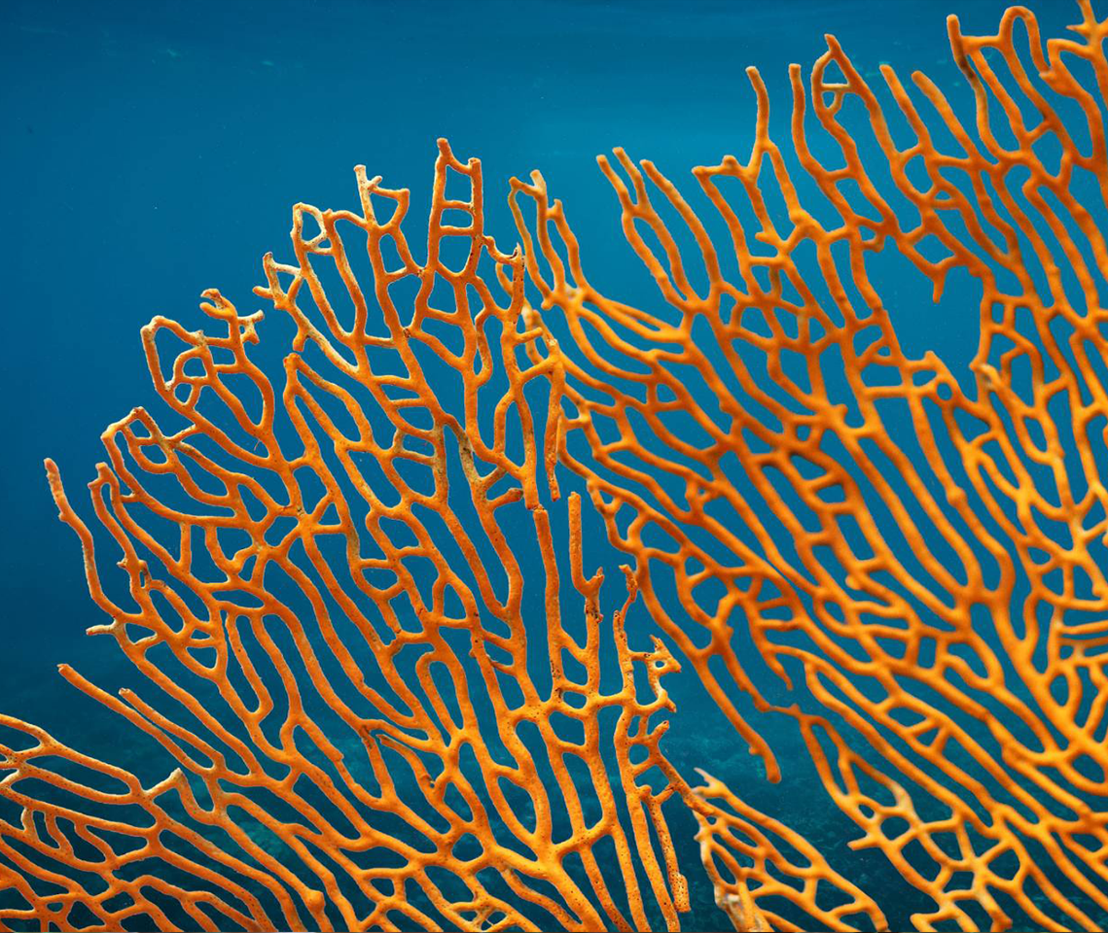
Volunteers
Needed
Registration/ sign in
Decorating
Sound
Opening/ closing
(Bro. Mike)
Sing / play (Barbara)
Kitchen personnel
Nursery
Security

Slide 3
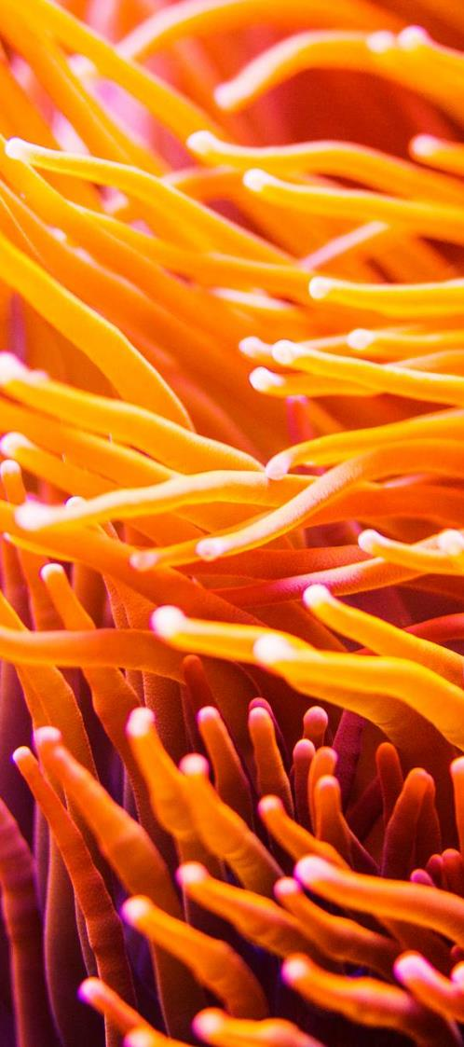
Older kids
Deep bible adventure leader
Imagination station (crafts)
Sticky scripture- this is new, it is bible verse memorization
Spotlight VBS- the person who takes all the pictures and makes the slide shows each day
6 positions for sing/play
Games leader with volunteers
1st grade crew leader
2nd grade crew leader
3rd grade crew leader
4-5th grade crew leader
We will need co-leaders to go along with them.
*If there are too many kids in one group despite the age I will even it out. There were too many last year in one group!

Slide 4
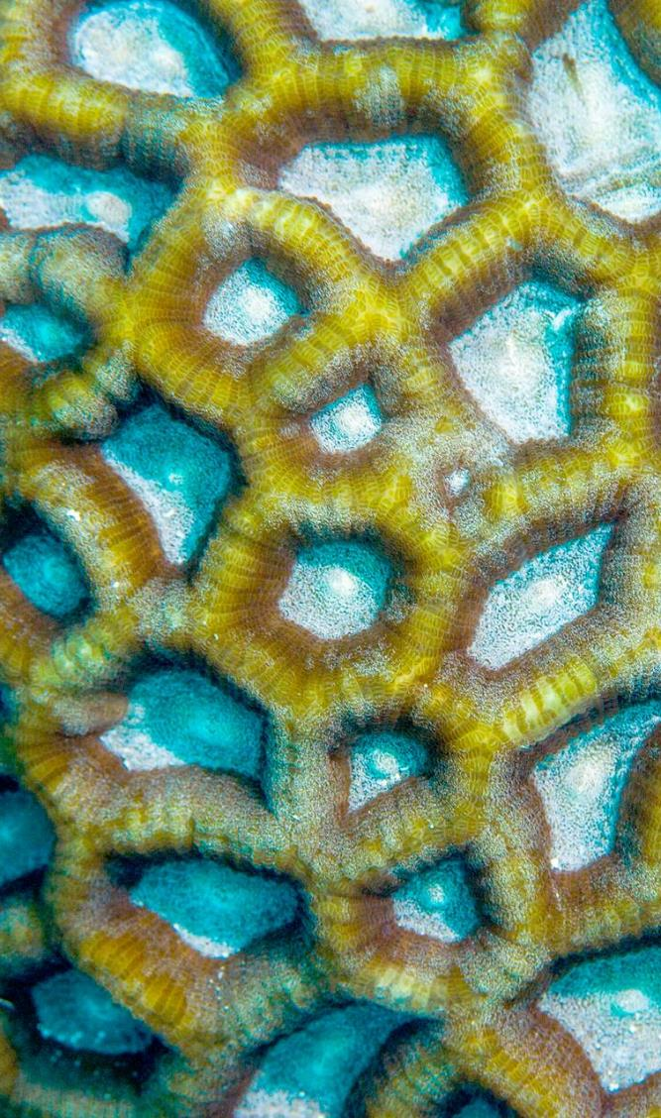
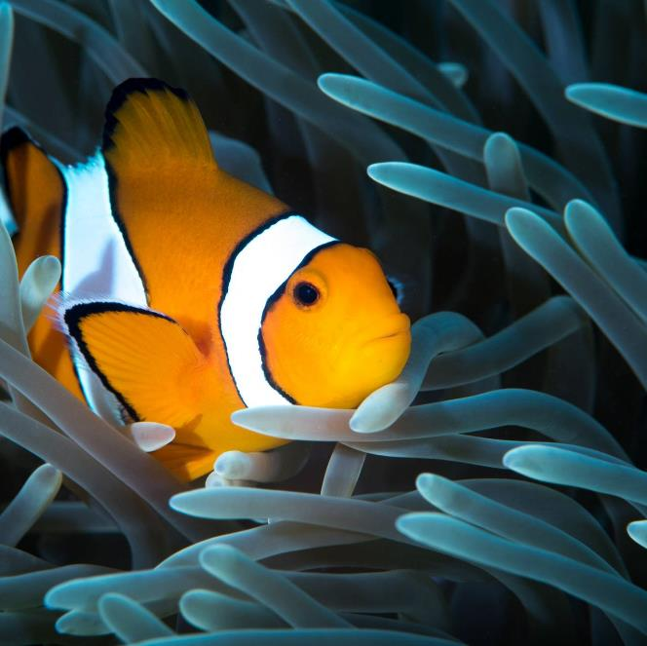
Preschool
Pre-k Director- Crystal Shauger
Bible adventures- Crystal Shauger
( she will need an assistant)
Exploration station – very messy! Will need a lot of volunteers!
Games
Craft/play
Sticky scripture- (Is new) bible memorization
3 yr old crew leader
4 yr old crew leader
5 yr old crew leader
Kindergarten crew leader
(will need co-leaders)

Slide 5

Supply coordinators
Liz Robinson / Susan Davis
Books will be handed out for your stations; supplies need to be ordered asap. Deadline for all supplies June 30. This to ensure plenty of time for last minute needs.
We will be having a craft night to help Mrs. Donna with some things for decoration. Be on the look out for that date.

Slide 6

Sticky Scripture
At sticky scripture, experiences help words in the Bible stick—to kids’ hearts and minds and lives! Here, kids dive in and explore each day’s Bible verse in a surprising way. Through an interactive video experience, kids are submerged into the undersea world on the SSCS—the Sticky Scripture Cyber Submarine. They’ll connect to each day’s Bible verse with their bodies, their heads, and their hearts. Led by a Bible Memory Buddy friend, kids will move, laugh, and play as they explore what each verse means to their lives in practical, applicable ways.

Slide 7
SING AND PLAY
This person will be responsible for the intro/ finale.
This person will be on stage in front of everyone doing the singing/ dancing.
There is a need for teens to join in the dance moves.
There is a short drama involved.
From my understanding this is what Morgan, Barbara, and Bro. Mike did last year.
Volunteers needed!

